Slide 1

Multi-Bay Battery Charger

Slide 2
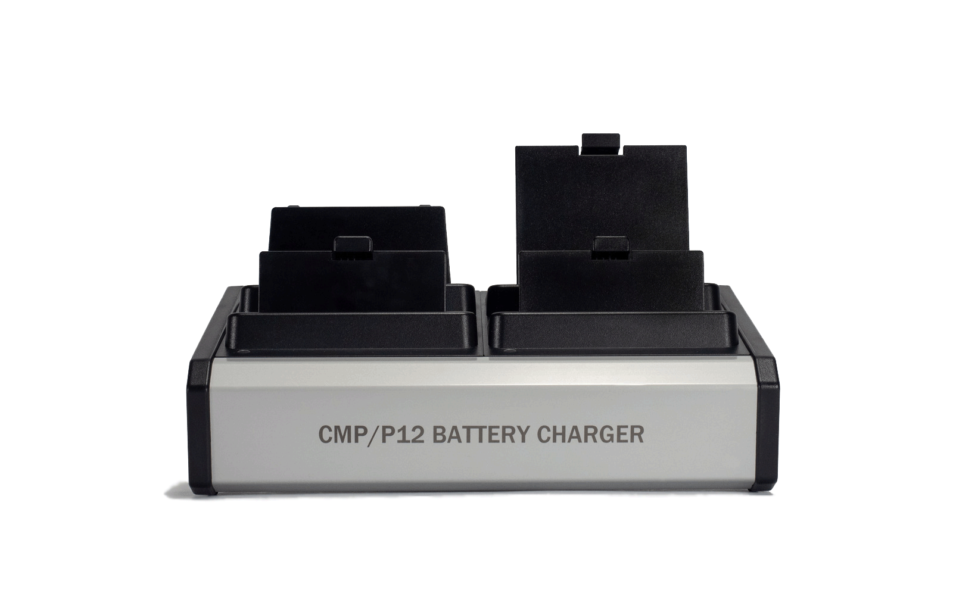
NEW MOBILE ACCESSORY
CMP/P12BTTCHRGR
Designed and built for flexibility.
Robust, fast, compact.
AVALIABLE NOW Q1 2019

Slide 3
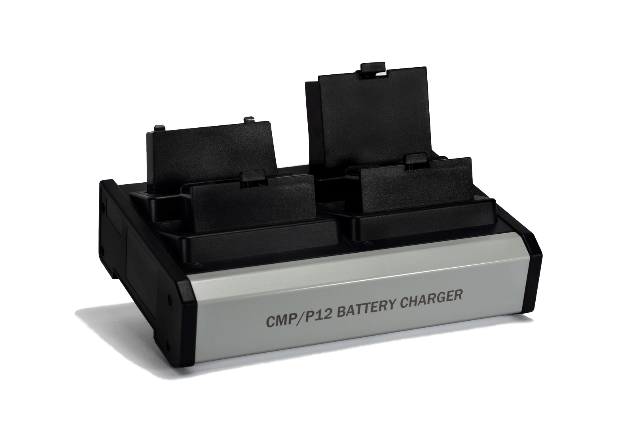
KEY FEATURES
Ability to restore life to four batteries simultaneously
High quality tactile engagement when loading batteries.
Compact size and overall footprint, to fit in small spaces
Easy, plug and play operation
USER FRIENDLY

Slide 4





APPLICATIONS
Point of Sale
Healthcare
Warehousing
Logistics
Retail

Slide 5
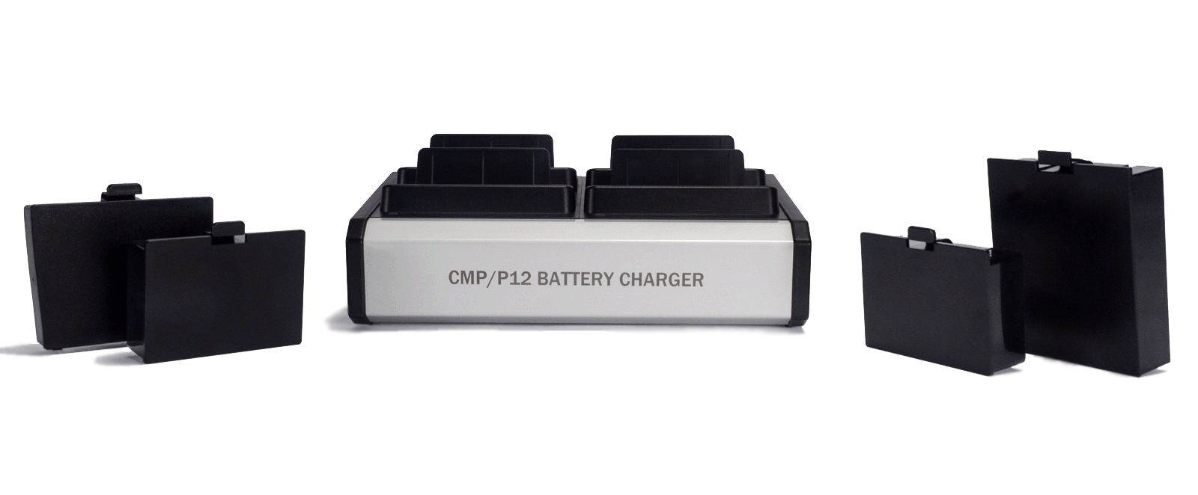
CHARGING CAPABILITY
Up to 7 hours of charging time
Standard CC/CV algorithm at 1000 mAh CC charge rate per battery.
Ability to charge ALL Citizen mobile batteries
  CMP-BA20 (P/N: LK-PB20)
  CMP-BA30 (P/N: LK-PB30)
  CMP-BA40 (P/N: LK-PB41)
CMP-BA20
CMP-BA30
CMP-BA40

Slide 6
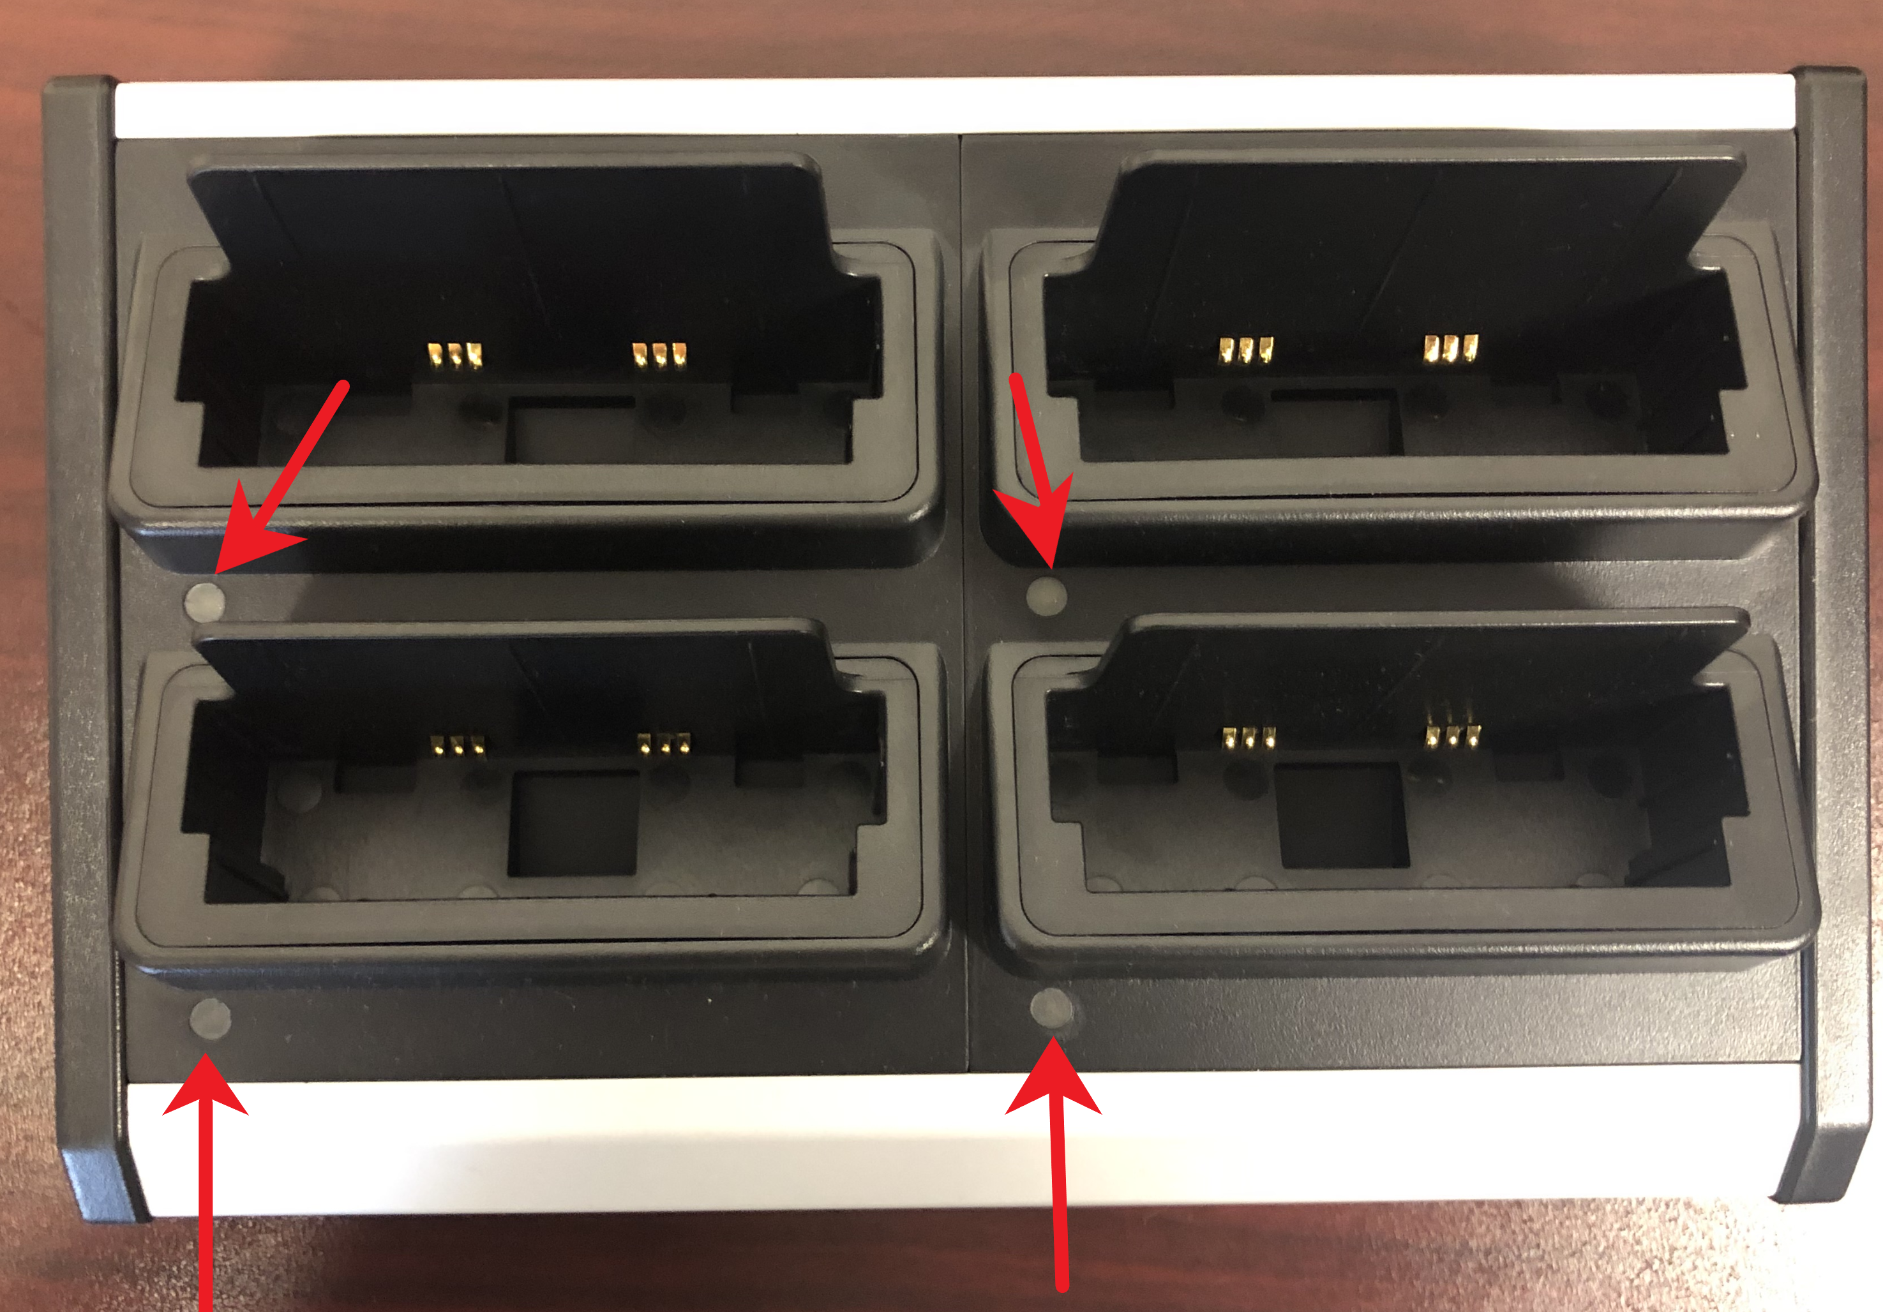
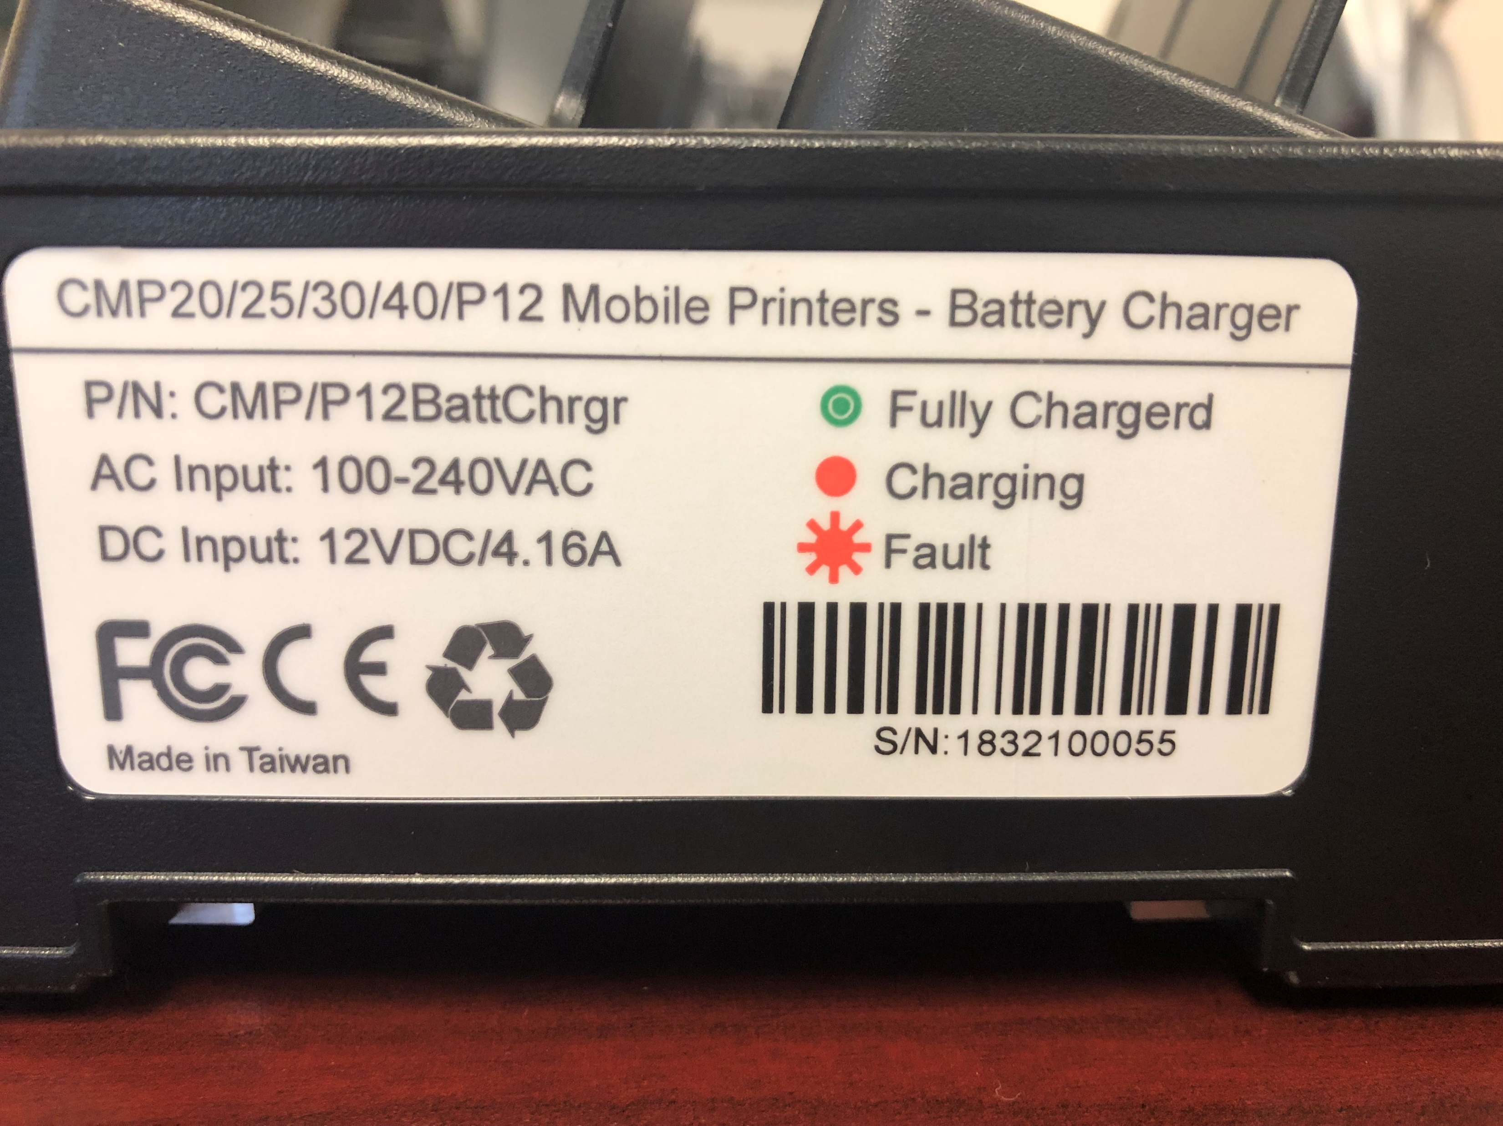
LED INDICATION
Solid red: Charging
Solid green: Charging complete
Flash red: Battery fault

Slide 7
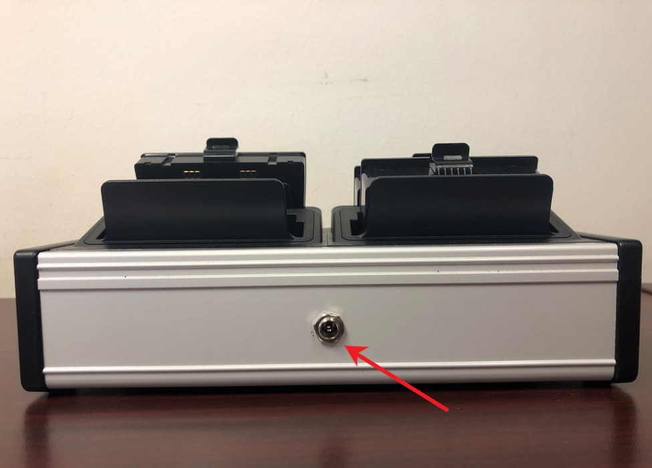
POWER
Note: AC/DC Power Cord

Slide 8
SPECIFICATIONS
Dimensions:
  6’ X 13’ X 3.5’
Weight:
  1.76lbs (0.798 kg)
Storage temperature:
  32°F to 113°F (0°C to 45°C )
Aluminum Frame
  Plastic charging ports

Slide 9
Pricing Addendum
MODEL NUMBER | PRODUCT TYPE | DESCRIPTION | MSRP | Disty
CMP | Accessory | New Mobile Accessory |  | 40%
CMP/P12BTTCHRGR | Acc | Cradle, Batt CHRGR 4BAY/CMP20-30-40-P12 | $275 | $165

